Slide 1
Trapping and Spin-Polarizing 47K for Nuclear Beta Decay Studies
Why trap and spin-polarize?
What does this mean and how do we do it?
Current status of 47K (our most recent isotope)
Hannah Gallop

Slide 2
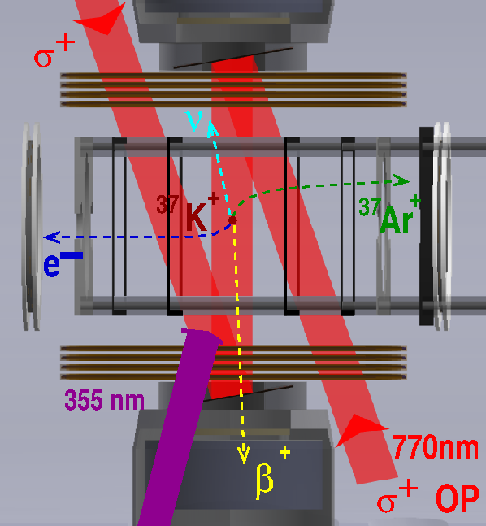
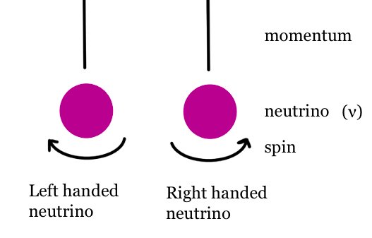
TRIUMF’S Neutral Atom Trap for Beta Decay (TRINAT)
TRINAT investigates the Standard Model's predictions for the weak interaction by looking at parity violations.
All known neutrinos are left-handed
Measuring the angle distributions tests whether there are right handed neutrinos
$W\left(θ\right)=1+PA_{ν}cos⁡(θ_{ν})$
Notes:
At TRINAT, we look for right-handed neutrinos by monitoring the nuclear beta decay of unstable potassium isotopes. Since B-decay is an example of a weak interaction, and the weak force violates parity conservation, there is an asymmetry in the direction of emitted decay products. Our observable, the angular distribution, depends highly on the spin-polarization of the potassium atoms. Thus to determine the neutrino asymmetry, we need to polarize our atoms, which we do through optical pumping and quantify the degree of polarization. We need the trap to be confined in one spot to do optical pumping and to be able to deduce information about the decay products.

Slide 3
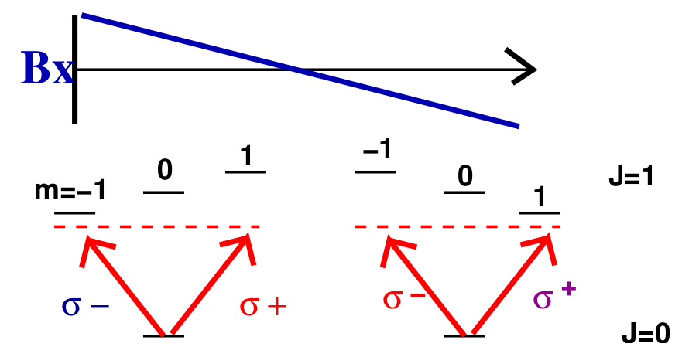
Trapping the atoms using a MOT, a damped harmonic oscillator
6 lasers tuned just below atomic transition frequency and a quadrupole B-field
An imbalance in radiative forces push the atoms to the center of the trap
John Behr, Student Symposium Talk
Notes:
We use a Magneto-Optical trap to thermally cool and spatially confine the atoms. The MOT is made up of 3 orthogonal pairs of laser beams with a quadrupole magnetic field which is created by having two coils with currents in opposite directions. The field is zero at the center of the trap and linearly increases in each direction, the Zeeman effect causes the energy levels to shift linearly as well, so the atoms position influences the Zeeman splitting of the sublevels. Consider an atom that has moved to where the magnetic field is negative along the x-axis, where the transition energy to get to the m=1 state is less than to get to the m=-1 state. Since both counter propagating lasers are slightly below the resonance frequency, the atom will absorb right circularly-polarized light but not left. The radiative force from this interaction causes the atom to be pushed back to the center of the trap. Since the lasers exist in all three dimensions, the atoms are spatially confined and will decay from rest (ish).

Slide 4
Trapping the atoms using a MOT
Trapped 47K, roughly 1000 atoms
DC (MOT always on)
AC (MOT on half the time)
Notes:
We also need a diagnostic to be able to tell in real-time if we are actually trapping any atoms. One of our tools that I worked on this summer is a camera that is set up at the view-port of the trap and captures snapshots of the flourencense of the atoms in the trap. To see the trap, we sum over ~35 images, then remove about 20pictures of background. Here are two images of 47 potassium being trapped. One is with a DC trap, and the other is running an AC trap. The AC trap has a larger trap area and is less condensed since in the time with the trap is off, they have the chance to spread out a little before being trapped again. We use AC often to alternate trapping with polarizing the atoms.

Slide 5
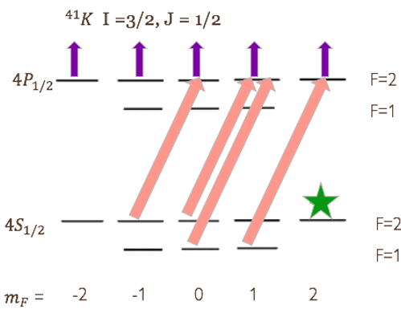
Spin-Polarized through Optical Pumping
$$\overset{⃑}{F}= \overset{⃑}{I}+\overset{⃑}{J}$$
The atoms in the MOT are polarized by using optical pumping to move the atoms into the fully-stretched state.
770nm circularly polarized laser excites atoms one hyperfine splitting to the right
Atoms then decay down to F=1 or F=2 state
Process continues until atoms are collected in |F = 2, mF = +2> (fully-stretched state)
Notes:
We polarize the atoms through the hyperfine structure, so when the atoms is polarized, it is both atomic and nuclear spin polarized. This is done through a process called optical pumping. Say we have 41K atom in this state, if we shine light with the correct transition frequency on it, it will absorb and jump up to the excited state. Since we use circularly polarized light, the m_F value will always increase or decrease by one, depending on its handedness. Assuming the light is right circularly polarized, mf will increase by one, then the atom will spontaneously decay randomly back down to its ground state. This process repeats over and over again with the mF value increasing so eventually the atoms will collect in the 2,2 state. At this point, the atom is dark to the light because there is no greater mF value for it to increase, as long as only right circularly polarized light is being used. When the atom is in that fully-stretched state, we can it spin-polarized.

Slide 6
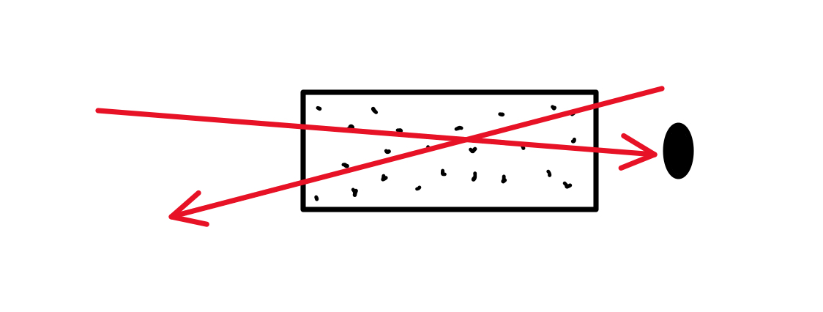
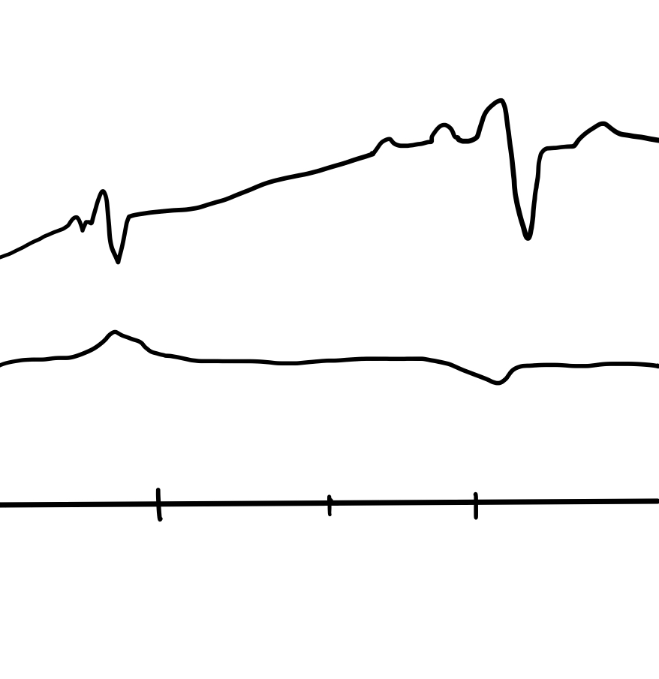
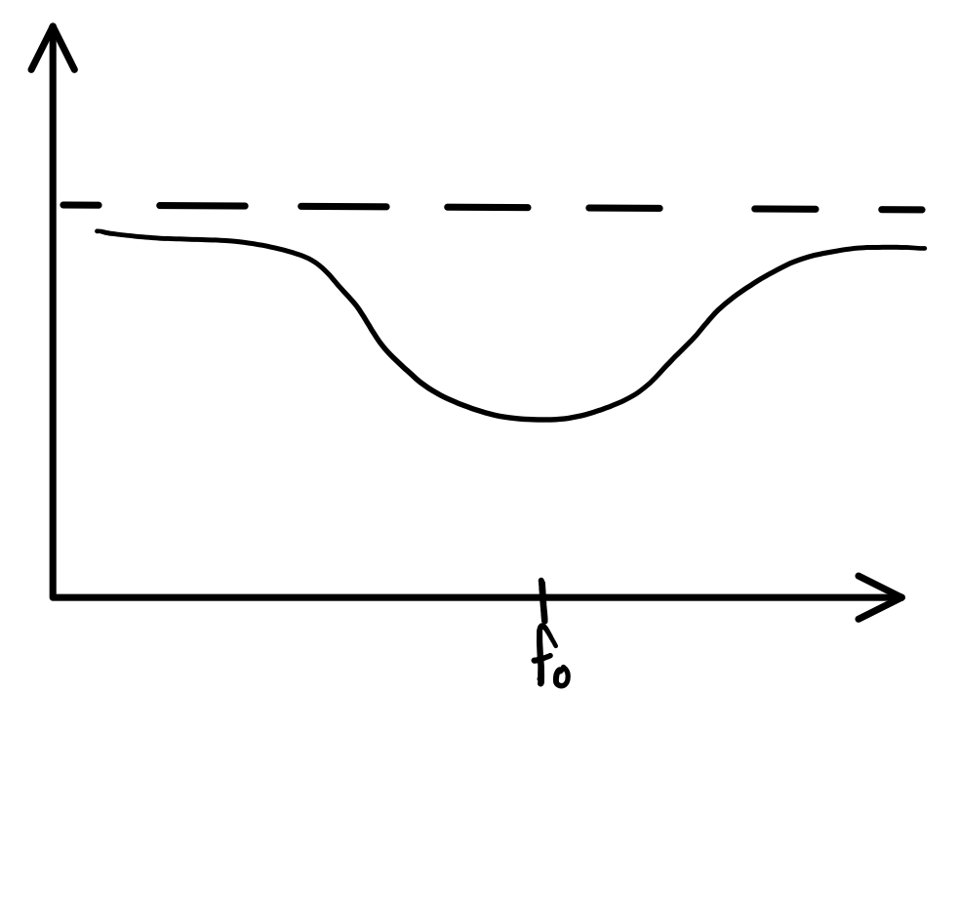
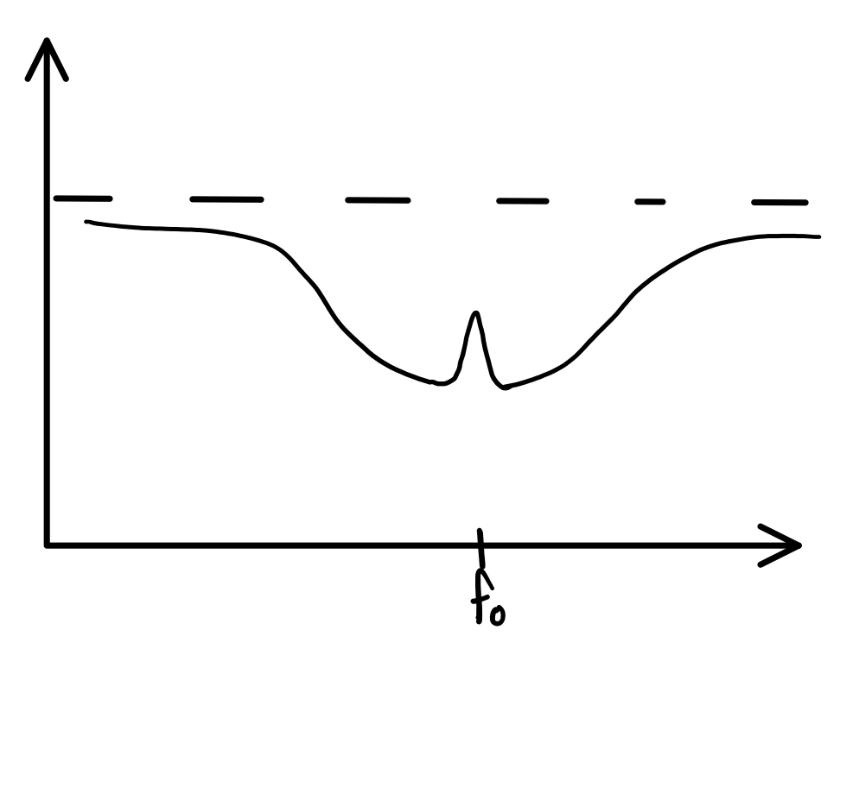
Locking the laser diode to the correct frequency
Saturated Spectroscopy Set up
Probe Beam
Vapor Cell
Use saturated absorption spectroscopy to find the resonance we need-> Done by looking at a vapor cell of ${}_{ }^{39}K$ (and other) and watching the absorption vs frequency curve
Photodiode
Pump Beam
Without pump beam
With pump beam
39K Sat Spec
100 MHz
Frequency
Frequency Splitting wrt ${}_{ }^{39}K$ cog
Frequency
Notes:
We have trapped different isotopes of potassium, so how to we get the correct transition frequency to optically pump the atoms (or to trap the atoms). We use saturated absorption frequency to lock onto a stable isotopes transition, in our case 39K, then adjust the frequency to our desired transition using acousto-optic modulators. For sat spec, we shine the laser through a vapor cell full of potassium 39, which has a photodetector at the end. The intensity of the laser decreases when it excites the atoms in the vapor cell, but since these atoms are moving we would actually see a range of frequencies excite different atoms due to the doppler effect. We then introduce a 'pump' beam which is stronger but pointed in the opposite direction, so when the lasers aren't at the atomic resonance they will excite different atom, but at the correct resonance, they excite the same atoms, so more of the probe beam makes it to the photodiode and we see a peak in the spectrum here. On the right here is part of the 39 potassium spectrum and there are multiple peaks because there are multiple transition possible in the atom. When we select a peak, we know what frequency the laser is at and then we increase or decrease the frequency as needed!

Slide 7
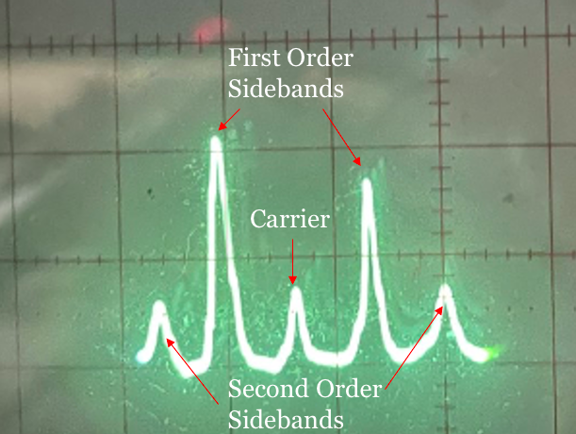
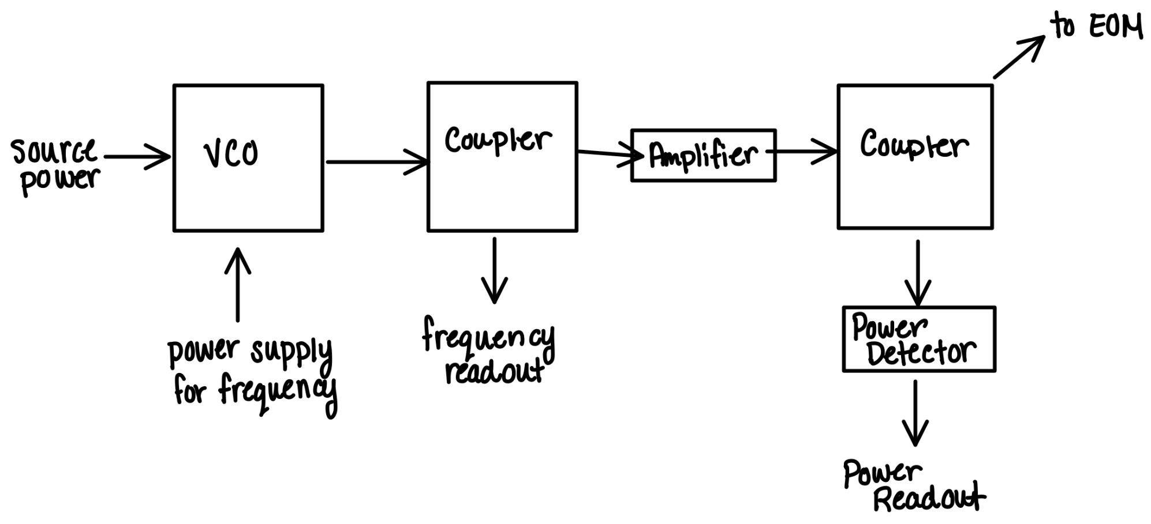
EOMs & Sidebands
Used to pump both transition into the excited state
Produces sidebands at a given modulation frequency
Carrier decreases as power increases
Notes:
Remember to optically pump the atoms, we need to pump from both the F=1 state and the F=2 state to the excited state, which requires two slightly different frequencies. Instead of using two lasers, we use an Electro-Optic Modulator (EOM) which can generate a sideband frequency to pump both of the transitions simultaneously. We lock to one of the transitions as shown in the previous slide, and send this light to the EOM. This frequency is called the carrier frequency. As we send power into the EOM, it creates sidebands at intervals at a modulation frequency (which we also control). As the power we send increases, the carrier losing power and the sidebands gain, and can create second or third order sidebands, no we need to balance how much power we need for each transition.

Slide 8
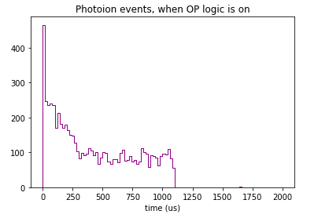
Measuring the Polarization
355nm to photoionize atoms in the excited state
$P ≈1 − \frac{21}{64}∗rate$
Notes:
If we remember our equation from the beginning, we need to quantify the polarization (to 10%?) to determine the asymmetry parameter. To do this, we introduce a UV laser into the trap, which has just enough energy to photoionize atoms in the excited state but not in the ground state. The laser photoionizes a sample of the excited atoms, and the resulting electron and recoil ion are then swept away by an electric field to our detectors where we can monitor the event rate at different times. During the start of an optical pumping cycle, we expect to see many atoms jumping to the excited state and moving around, so we expect to see a higher photoionization rate. Later in the cycle, when more atoms have collected in the fully-stretched state and arent being excited anymore, we expect to see the photoionization rate drop. To make an estimate for the polarization, I take the ratio between these two rates and then adjust it by an estimate based off of transitions strengths and other possible states to come up with a number between 0 and 1, where 1 is completely polarized.

Slide 9
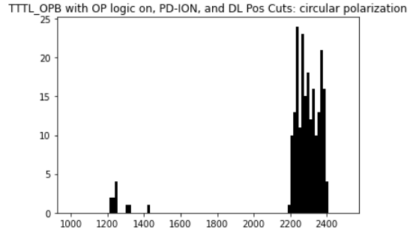
47K Polarization Progress
Trapped and Polarized 47K in our latest beamtime
47K has a lower event rate
Analysis is on-going
MOT Light
41K P = 96 ± 4%
47K P = 96 ± 5%
Notes:
So in our most recent beamtime we were actually able to trap 47 potassium, and using the method described on the previous slide I was able to find a preliminary indication of polarization of the atoms. Compared to 41K potassium, we had a lot more background and fewer photo-ion events and we had to do many more cuts on our data.

Slide 10
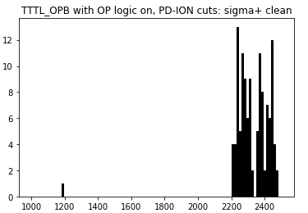
Update to 47K Polarization
Discovered one run was skewing our circularly polarized data
Lose the ‘significant’ peak we saw at the beginning of the OP cycle
Ratio between linear polarization and circular polarization during OP indicates that we may still be polarizing our atoms
OP cycle should be during this time
Notes:
We cut out run4389 (where we were unsure of polarization of OP arm) to see that the peak during the beginning of the OP cycle changed dramatically, and only has one event.

Slide 11
Thank you
Questions?
Thanks to my supervisor, John Behr, and the rest of the TRINAT team

Slide 12
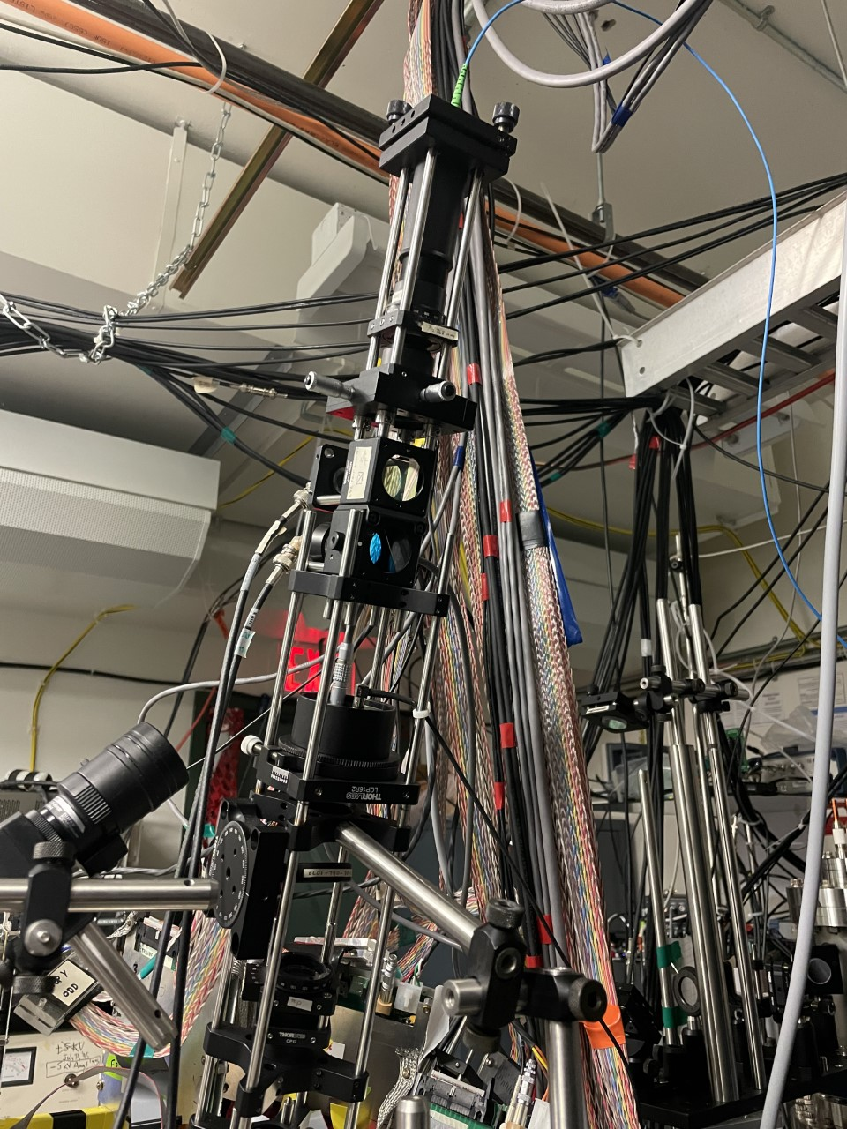
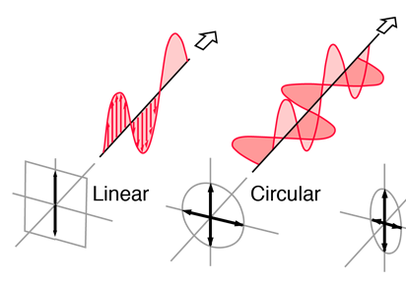
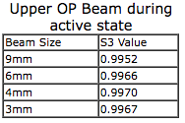
OP Laser Polarization
Polarizing Maintaining Optical Fiber
Circularly Polarized Light ($±σ$)
Stokes Parameters: S₃ represents circular
$S_{3}= \sqrt{1−(S_{1}^{2}+S_{2}^{2})}$
Need $±σ$ light due to its ability to $Δm= ±1$ to polarize the atoms
Classification of Polarization. (n.d.). http://hyperphysics.phy-astr.gsu.edu/hbase/phyopt/polclas.html
Polarizing Beamsplitters
Important Optical Devices Used
TNLC
Quarter Waveplates: linear pol to circular pol
Polarizing Beamsplitters: transmits horizontal, reflects vertical
Twisted Nematic Liquid Crystal (TNLC): flips between horizontal/vertical
Quarter Waveplate

Slide 13
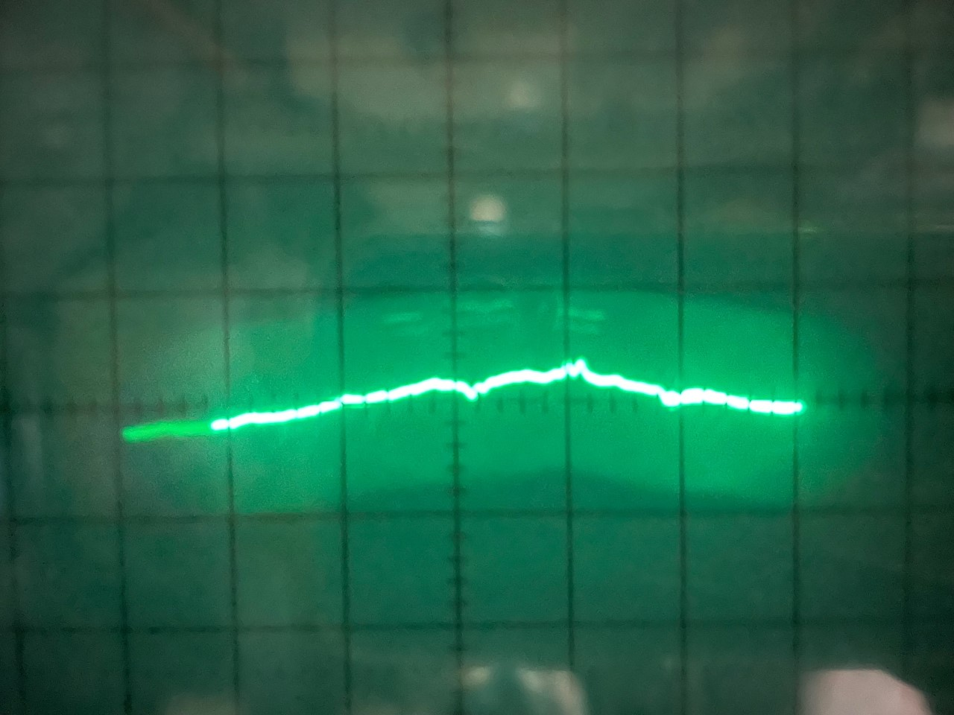
Locking the laser diode to the correct frequency
39 K
Lock to a transition in ${}_{ }^{39}K$ (a stable isotope)
Multiple peaks visible since there are multiple possible transitions
Adjust voltage and current going to laser diode until centered on peak
F’ = 2
F’ = 1
309.4 MHz
Locked to here
F = 2
Calculating the isotope shifts:
$$H_{HFS}=−μ_{I}∙B_{e}=A\overset{⃑}{I}∙\overset{⃑}{J}$$
$$E_{HFS}=A<\overset{⃑}{I}∙\overset{⃑}{J}> =\frac{A}{2}[F\left(F+1\right)−I\left(I+1\right)−J(J+1)]$$
F = 1
45 K
F’ = 2
F’ = 1
To get from ${}_{ }^{39}K$ transition to ${}_{ }^{45}K$ transition:
Acousto-Optic Modulators (AOMs) are able to shift the frequency by a given amount, depending on the input voltage.
593.6
MHz
100 MHz
200 MHz
300 MHz
F = 2
Frequency Splitting wrt ${}_{ }^{39}K$ cog
F = 1

Slide 14
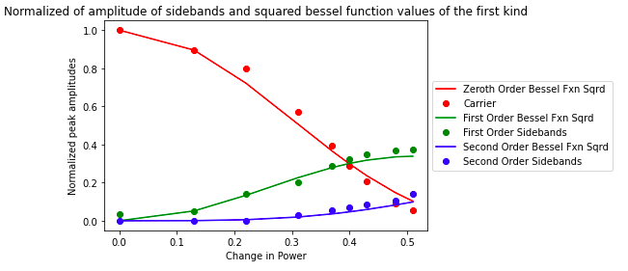
EOMs & Sidebands
Notes:
Remember to optically pump the atoms, we need to pump from both the F=1 state and the F=2 state to the excited state, which requires two slightly different frequencies. Instead of using two lasers, we use an Electro-Optic Modulator (EOM) which can generate a sidebands frequency to pump both of the transitions simultaneously. We lock to one of the transitions as shown in the previous slide, and send this light to the EOM. This frequency is called the carrier frequency. As we send power into the EOM, it creates sidebands at intervals of a given frequency (which we also control). As the power we send increases, the carrier losing power and the sidebands gain, and can create second or third order sidebands, no we need to balance how much power we need for each transition

Slide 15
Notes:
We want a quadrupole magnetic field during the trap time and a uniform magnetic field during the pumping time.

Slide 16
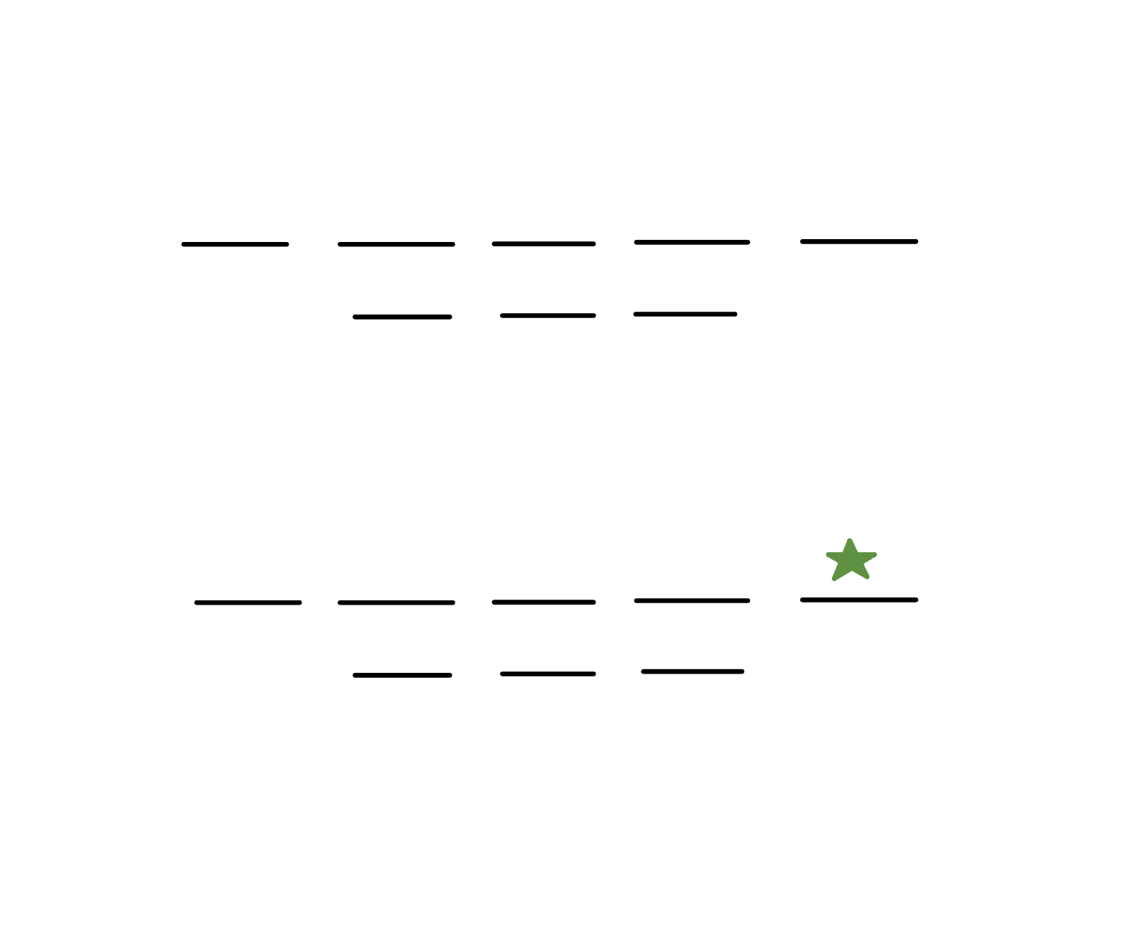
Measuring Polarization
355 nm laser to photoionize the atoms in the excited state
$P≈1 − \frac{21}{64}(\frac{tail}{peak})$
$P\left({}_{ }^{41}K\right)=0.96 ±0.04$
${}_{ }^{41}K$ I =3/2, J = 1/2
$$4P_{1/2}$$
F=2
F=1
$$4S_{1/2}$$
F=2
F=1
$m_{F}$=
-2
-1
0
1
2

