Slide 1
Sweeping Magnetic Field on Neutral Atom Trap
Anya Forestell, TRINAT
Supervisor: Dr. John Behr
amforest@edu.uwaterloo.ca

Slide 2
Table of Contents
TRINAT Overview
Power supply communication
Near Helmholtz simulations
Camera setup
Current Sweep
What next?

Slide 3
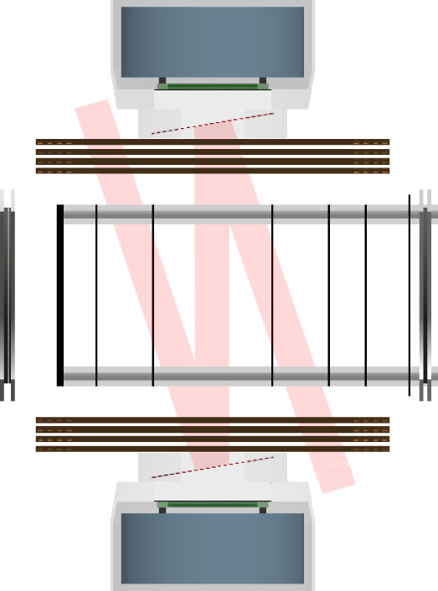
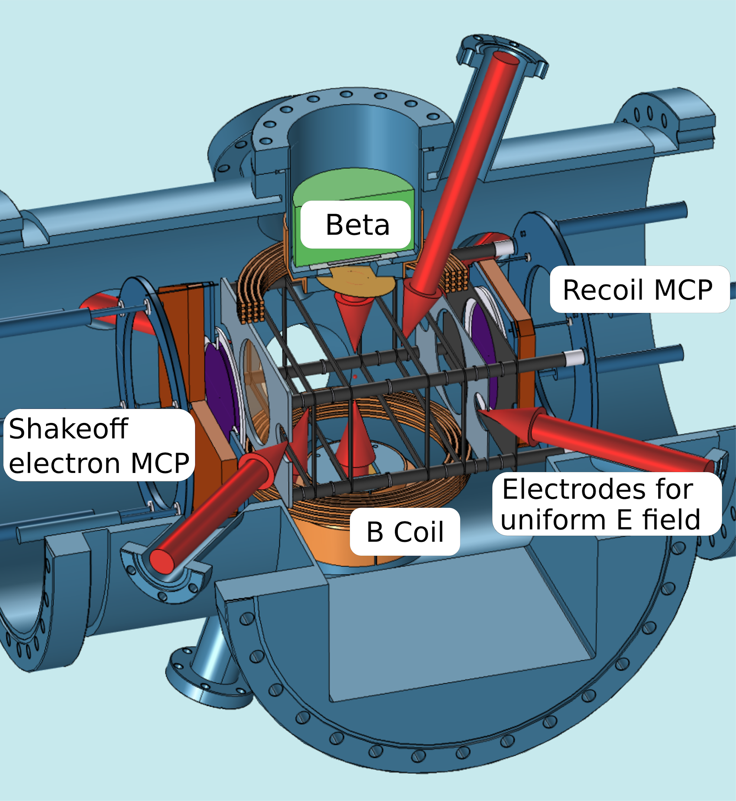
TRINAT Overview
Polarization Axis
Fenker et al., PRL, 2018.

Slide 4
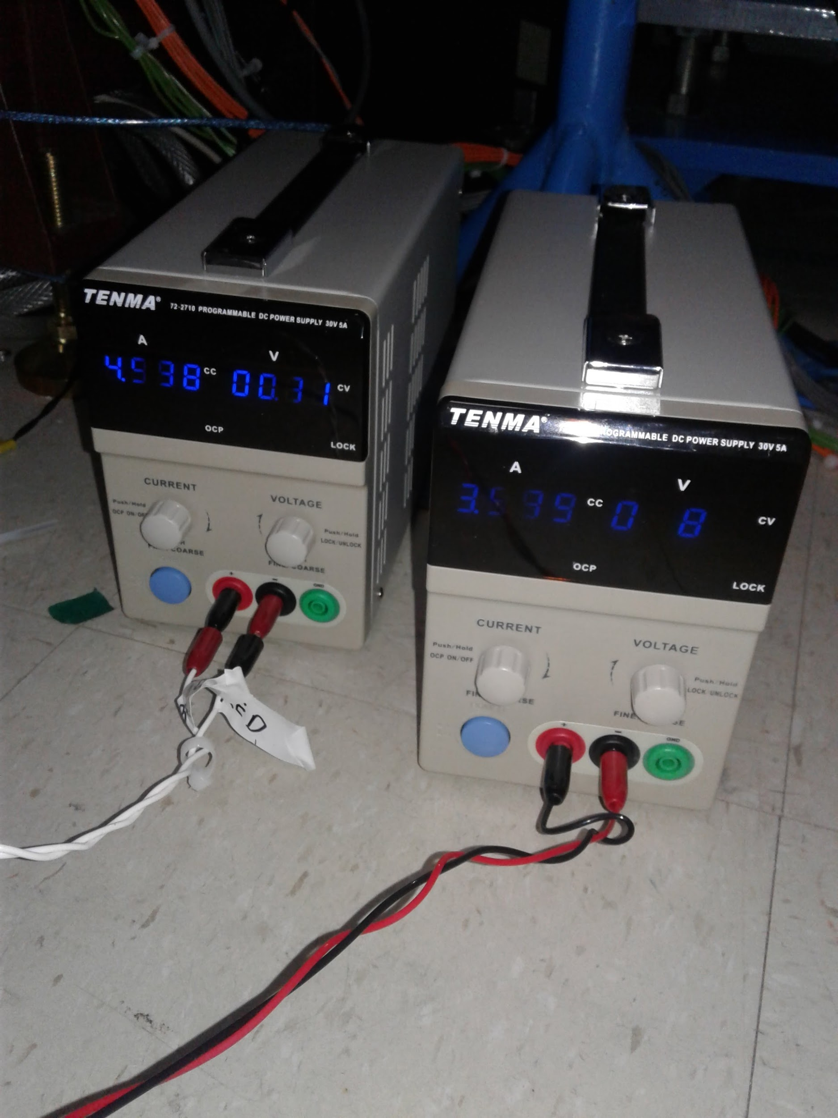
Power Supply Communication
Moserial, CuteCom, GtkTerm
None quite worked
C++ code
No answers from power supplies
Python code
Worked!

Slide 5
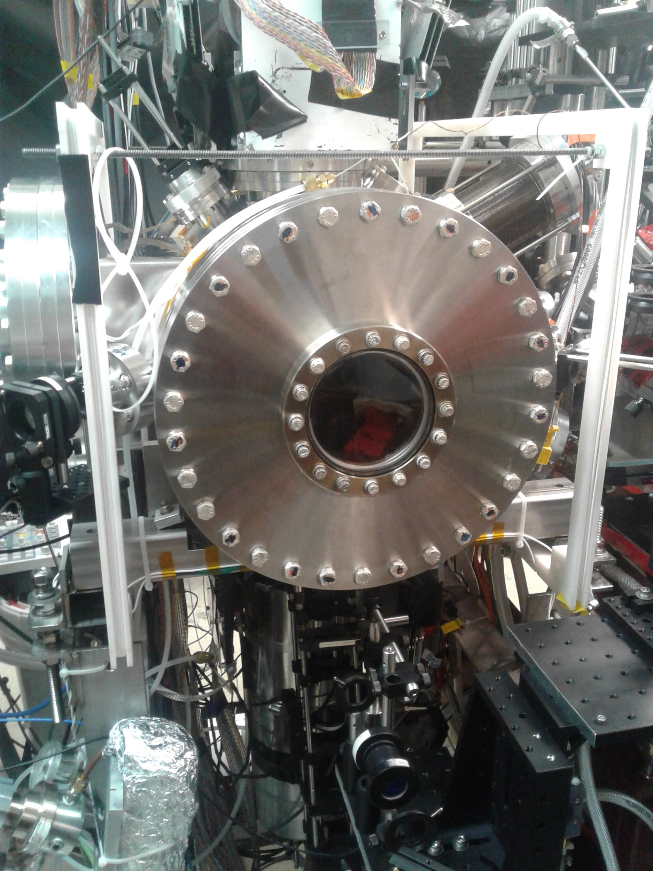
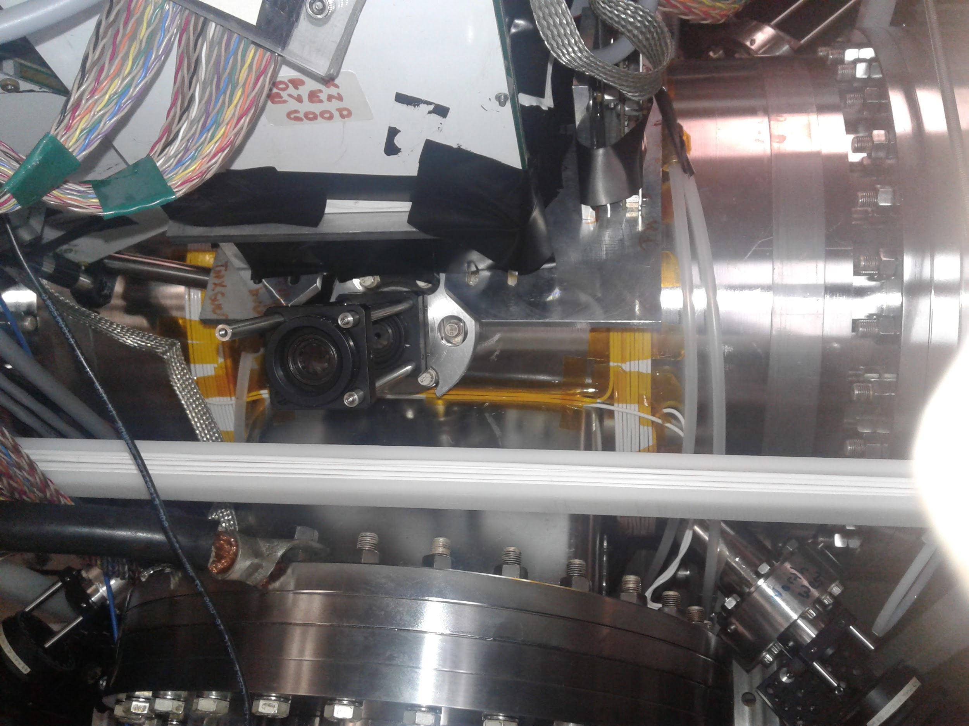
Near-Helmholtz Simulation

Slide 6
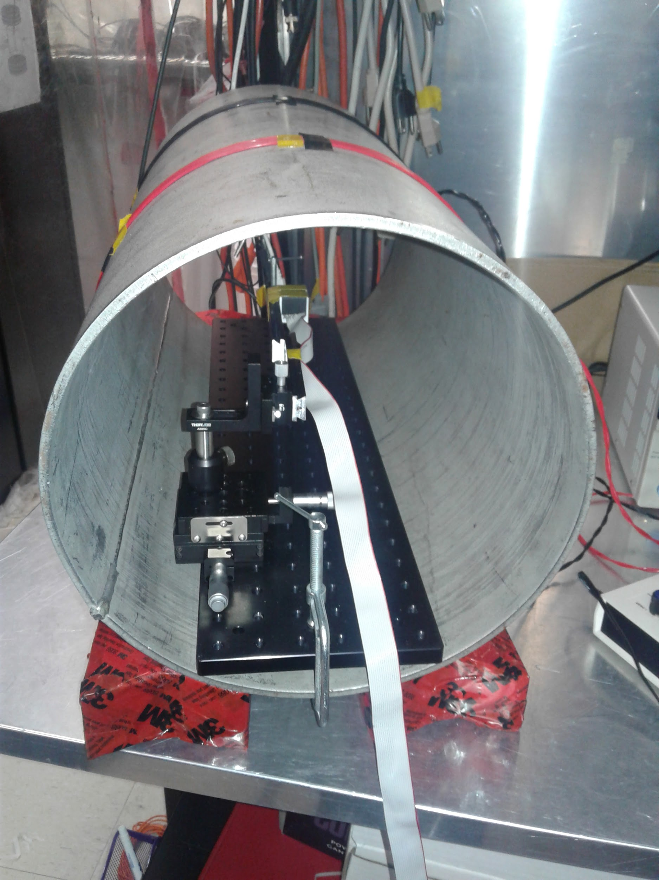
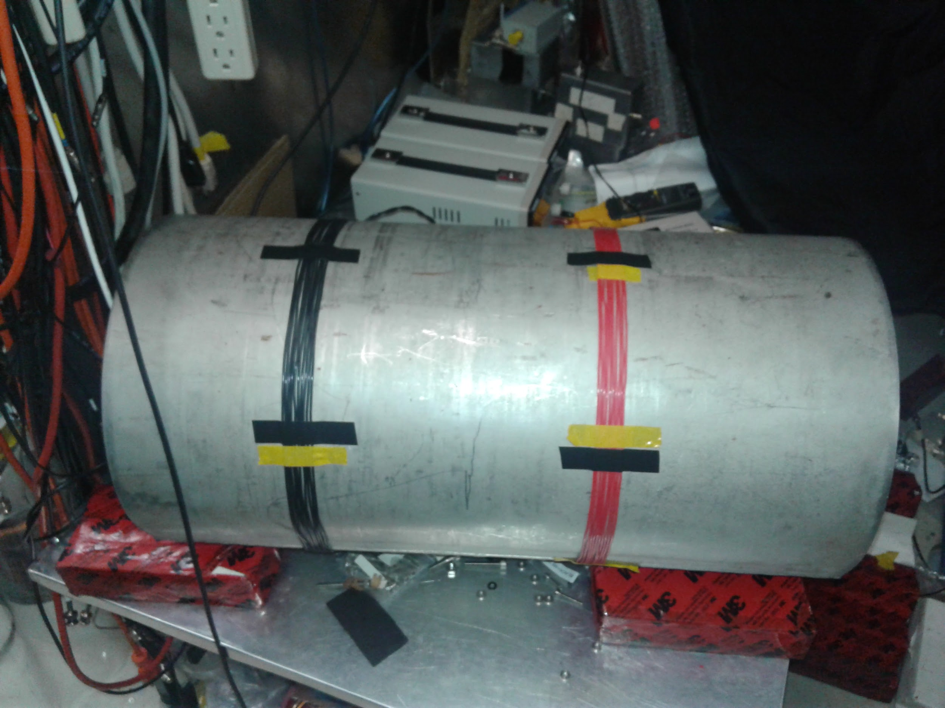
Near-Helmholtz Simulation

Slide 7
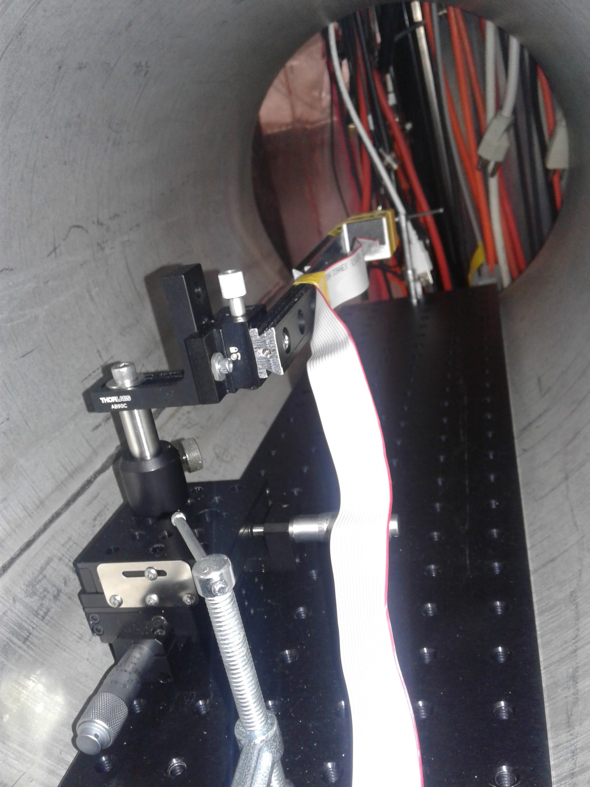
Near Helmholtz Simulation
Design
Field measurements
Anti-Helmholtz
Helmholtz
Z
Probe
X
Y

Slide 8
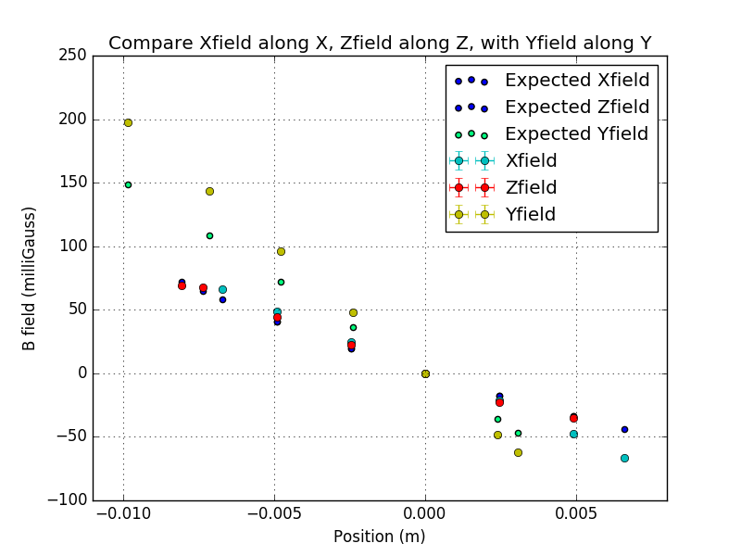
Near-Helmholtz Simulation
Anti-Helmholtz Coils
Constant current: 4A
Measured:
X field along X axis
Y field along Y axis
Z field along Z axis
Others are 0 due to coil symmetry

Slide 9
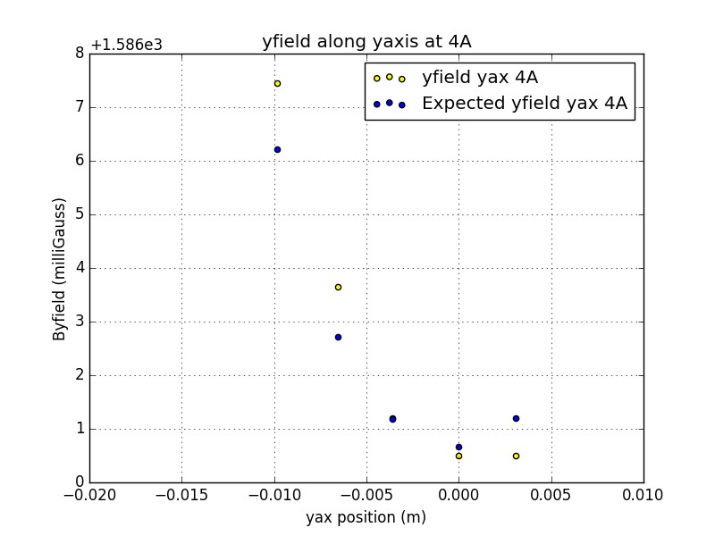
Near-Helmholtz Simulation
Helmholtz Coils
Current: 1A - 5A
Measured:
X field along X axis
Y field along all axes
Z field along Z axis
Others are 0 due to coil symmetry
Example: Y field along Y axis at 4A

Slide 10
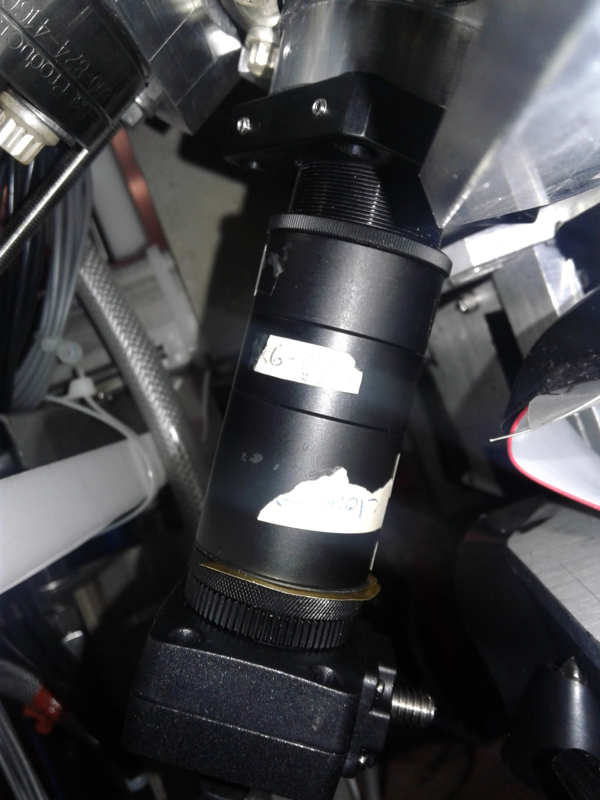
Camera Setup
Trap
Design/setup
Firefly camera
System of lenses
250mm lens
Red glass filter
30mm lens
Camera

Slide 11
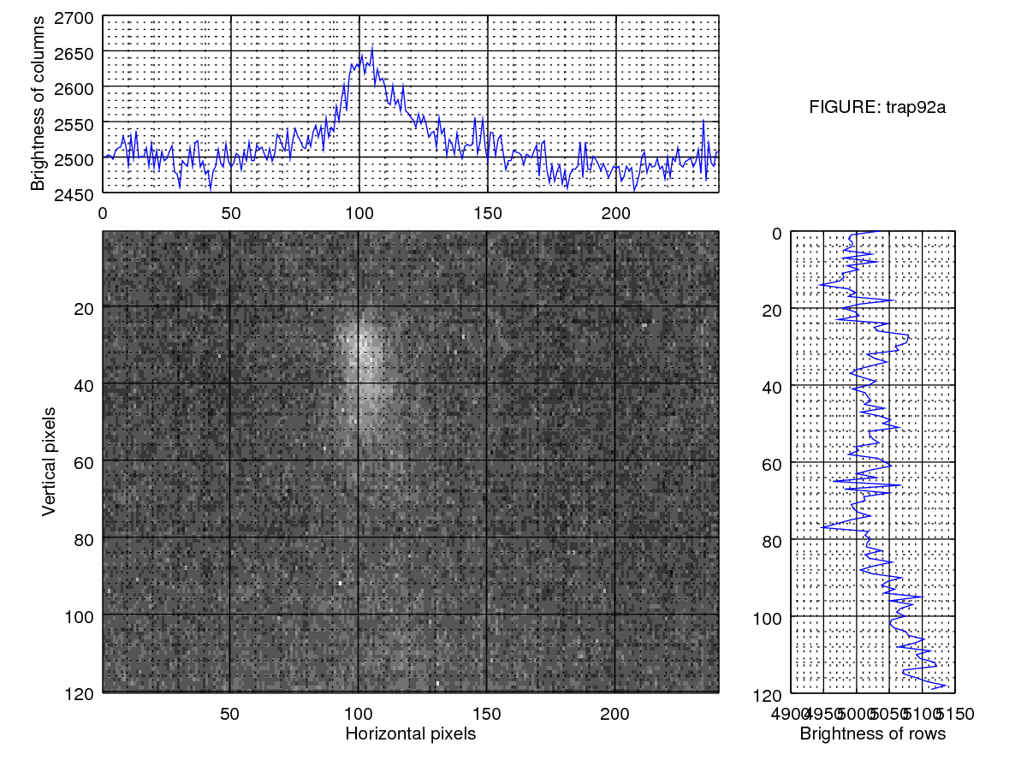
Lamp and Target Images
Center of cloud: 0.15mm x 0.05mm off

Slide 12
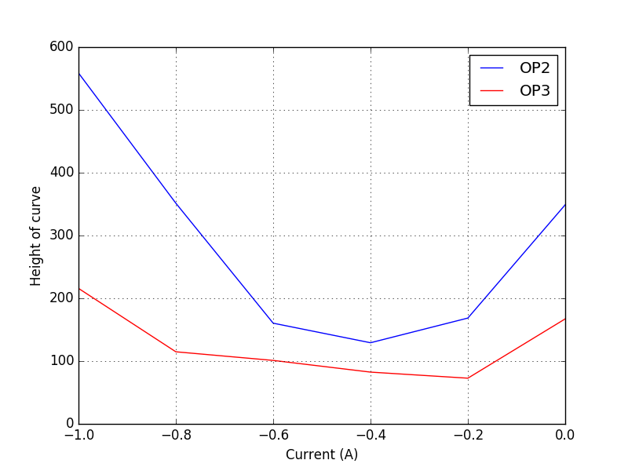
Current sweep: Uniform Magnetic Field
Balanced coils
Current sweep: -1.0A - 0.0A, steps of 0.2A
Optimized current confirmed: -0.44

Slide 13
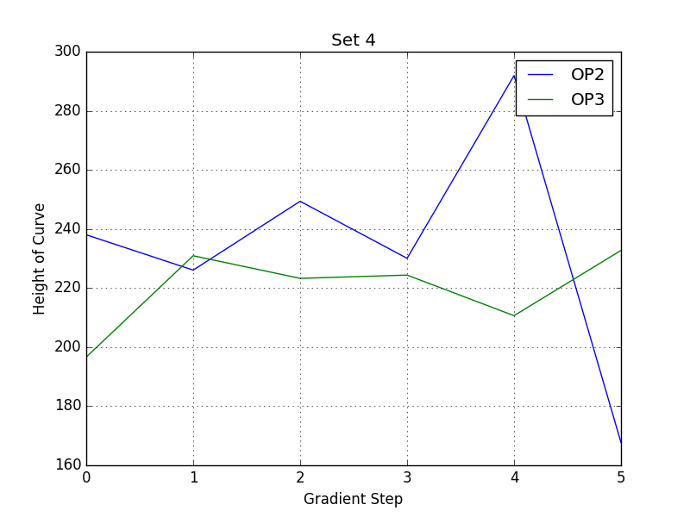
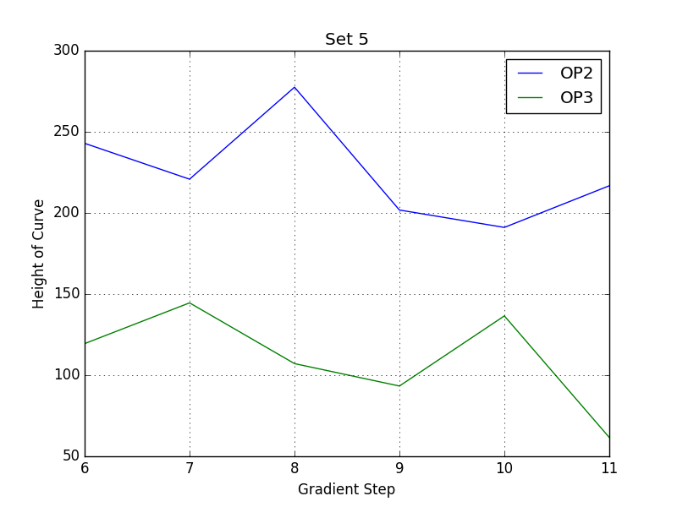
Current Sweep: Gradient Magnetic Field

Slide 14
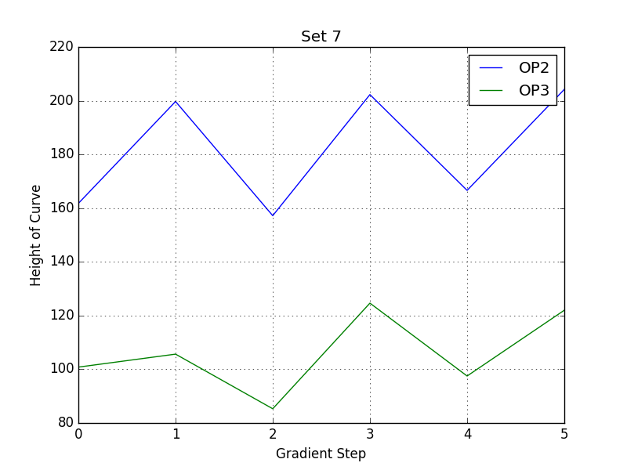
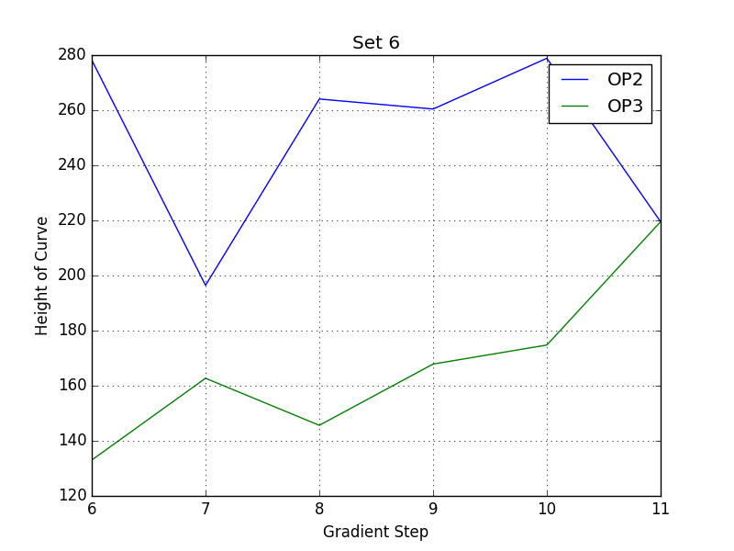
Current Sweep: Gradient Magnetic Field

Slide 15
What next?
Sweep bigger gradients
Take more data to get clearer trend (and smaller steps of gradient)
Create predictive model and compare data to it
Better probe sensitivity

Slide 16
Thank you!
Questions?

